Slide 1



Visualization in Smart Manufacturing
Dong SUN
The Hong Kong University of Science and Technology

Slide 2

Introduction
Visualization in Smart Manufacturing
Sequence Synopsis: Optimize Visual Summary of Temporal Event Data
ViDX: Visual Diagnostics of Assembly Line Performance in Smart Factories
HKUST
Notes:
This is the outline of the presentation.
First, I will introduce the background and motivation of visualization in Industry 4.0.
Then, I will present a taxonomy based on challenges in Industry 4.0 and the lifecycle of manufacturing.
After that, I will illustrate the four categories given by the taxonomy, namely, planning and scheduling visualization, manufacturing simulation visualization, manufacturing process visualization, and supply chain visualization.
Finally, I will conclude the work and make suggestions on directions of future research.

Slide 3
Industrial Revolution
Introduction
The Rise of Industrial Big Data
What is “Smart”?
Potential Application Scenarios
HKUST
Notes:
First, let me introduce you the background and motivation of visualization in Industry 4.0.

Slide 4






Industrial Revolution
Introduction
1.
Industry 4.0
The people, devices and systems in the value chain are connected.
All the related information is accessible in real time.
The components in the value chain are continuous optimized to meet personalized requirements.
1.
2.
2.
3.
Industrial revolution
3.
4.
Industrial revolution
Industrial revolution
Industrial revolution
1st industrial revolution
2nd industrial revolution
3rd industrial revolution
4th industrial revolution
In 1969, the first programmable logic controller (PLC) , Modicon 084, was created.
In 1784, the first loom was created.
In 1870, the first conveyor belt was created at the Cincinnati Slaughterhouse.
The implementation of the physical information system.
1800
1900
2000
now
HKUST
Notes:
Since we collaborated with analysts from Automotive industry, we also focus on the car faults sequences.
Cars are complex system and contain many modules.
Car modules like…
Nowadays most can brands…
The emitted fault signals forms a sequence of car faults.

Slide 5

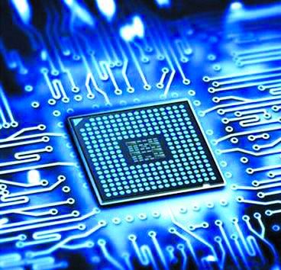

The Rise of Industrial Big Data
Introduction
Industry 4.0 (Germany), Industrial Internet (America), and Made in China 2025 (China): Emphasize the use of big data. Big data is an important feature in future.
The main factors for the rise of big data in the industrial field:
Human experience and analysis cannot satisfy the requirement of the complex management.
The vast amount of data generated in the manufacturing process are not fully dug.
The development of sensing and communication equipment makes it cheap to access real-time data.
Cloud computing provides computing power for big data processing.
HKUST
Notes:
Since we collaborated with analysts from Automotive industry, we also focus on the car faults sequences.
Cars are complex system and contain many modules.
Car modules like…
Nowadays most can brands…
The emitted fault signals forms a sequence of car faults.

Slide 6



What is “Smart”?
Introduction
Artificial intelligence: Simulate and extend human intelligence through computer programs. It summarizes patterns from phenomena and provides tools for people.
Super doctors
Go master
Smart eyes
HKUST
Notes:
Since we collaborated with analysts from Automotive industry, we also focus on the car faults sequences.
Cars are complex system and contain many modules.
Car modules like…
Nowadays most can brands…
The emitted fault signals forms a sequence of car faults.

Slide 7
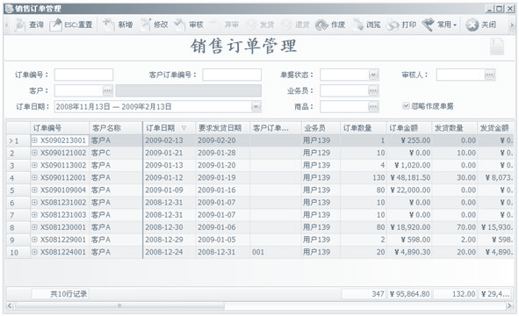
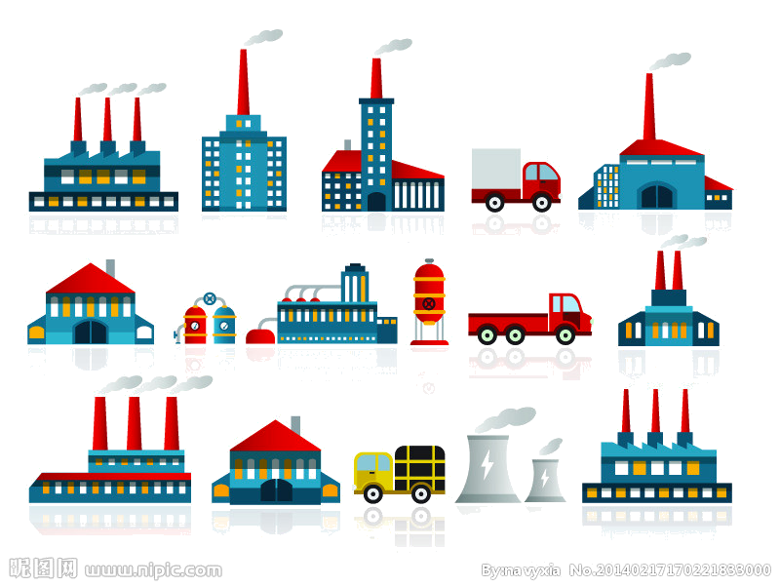




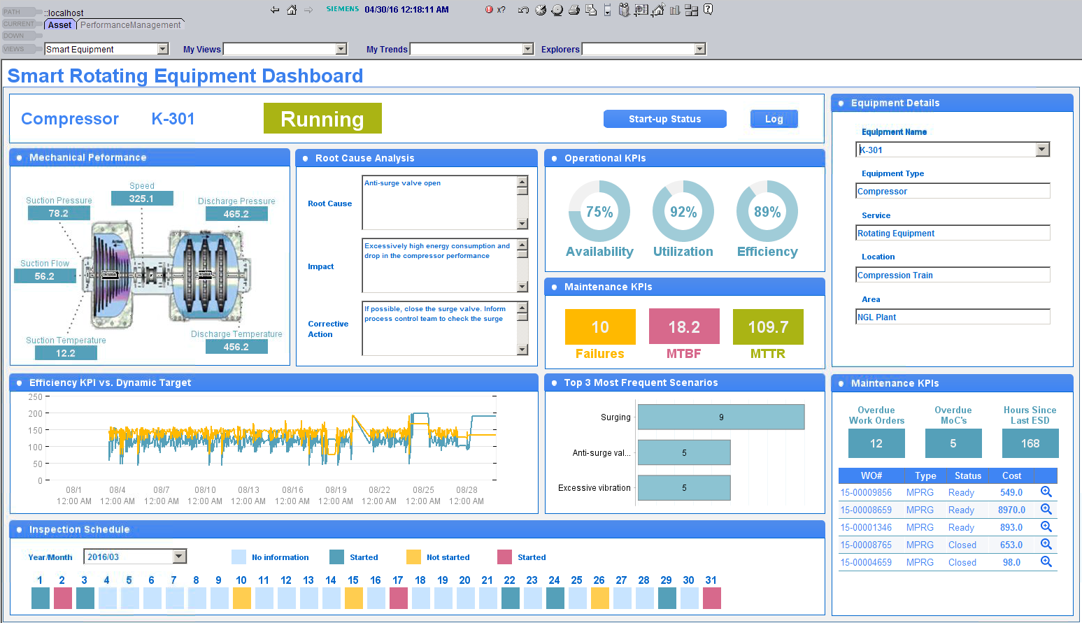
Potential Application Scenarios
Introduction
Reporting tools
Analysis decision tools
Problem
devices
manufacturing
management
?
知识
(人)
data
model
Enterprise-level central database
Interactive and intelligent data analysis tools
Data scientist
Domain expert
HKUST
Notes:
Since we collaborated with analysts from Automotive industry, we also focus on the car faults sequences.
Cars are complex system and contain many modules.
Car modules like…
Nowadays most can brands…
The emitted fault signals forms a sequence of car faults.

Slide 8
Opportunities and Challenges
Visualization in Smart Manufacturing
Research Taxonomy
Planning and Scheduling Visualization
Manufacturing Simulation Visualization
Manufacturing Process Visualization
Supply Chain Visualization
Conclusion and Future work
HKUST
Notes:
First, let me introduce you the background and motivation of visualization in Industry 4.0.

Slide 9
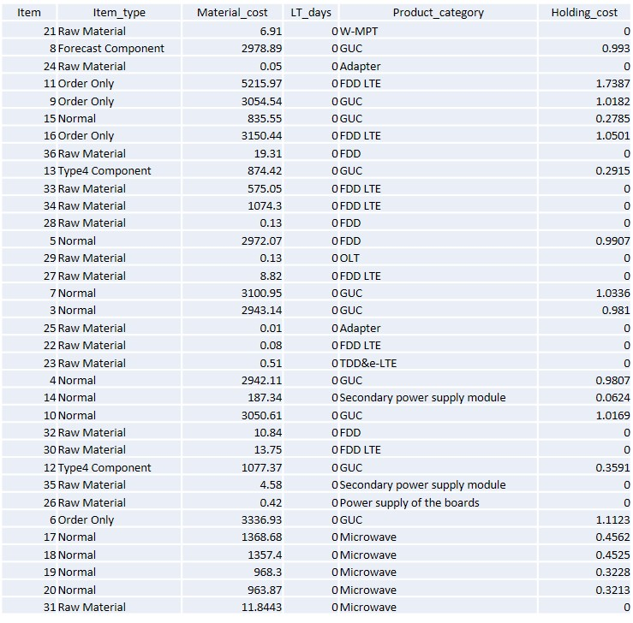
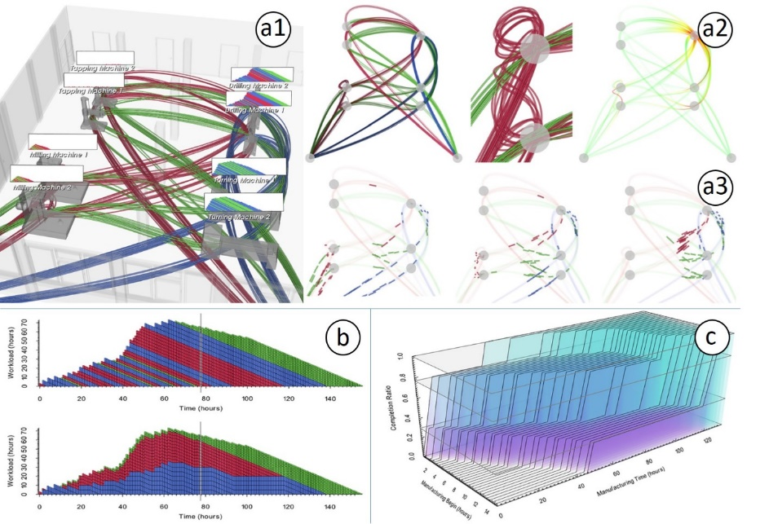
Opportunities and Challenges
Visualization in Smart Manufacturing
Manufacturing data are collected and network-accessible.
Visualization helps analyze manufacturing data.
(Post et al., 2017)
Journal of Computing and Information Science in Engineering
Traditional: table data, tedious, inefficient.
Visualization: intuitive, easy, effective.
HKUST
Notes:
Since we collaborated with analysts from Automotive industry, we also focus on the car faults sequences.
Cars are complex system and contain many modules.
Car modules like…
Nowadays most can brands…
The emitted fault signals forms a sequence of car faults.

Slide 10
Opportunities and Challenges
Visualization in Smart Manufacturing
Difficulty in understanding, analyzing, and optimizing product manufacturing.
1. complex systems
decode the complex system
2. sheer number of data
bridge the gap between humans and data
3. professional knowledge required
do not require expertise
4. advanced algorithms
explain the algorithm result
Visualization
HKUST
Notes:
Since we collaborated with analysts from Automotive industry, we also focus on the car faults sequences.
Cars are complex system and contain many modules.
Car modules like…
Nowadays most can brands…
The emitted fault signals forms a sequence of car faults.

Slide 11
Research Taxonomy
Visualization in Smart Manufacturing
The taxonomy is based on:
1. The challenges and opportunities brought about by Industry 4.0
The changeability and various constraints of planning and scheduling.
Vast simulation runs and complex manufacturing systems.
Complicated state info and unpredicted risks in production processes.
The globalization, hierarchy, and uncertainty of supply chains.
2. The lifecycle of product manufacturing
plan
simulation
production
supply
HKUST
Notes:
Since we collaborated with analysts from Automotive industry, we also focus on the car faults sequences.
Cars are complex system and contain many modules.
Car modules like…
Nowadays most can brands…
The emitted fault signals forms a sequence of car faults.

Slide 12
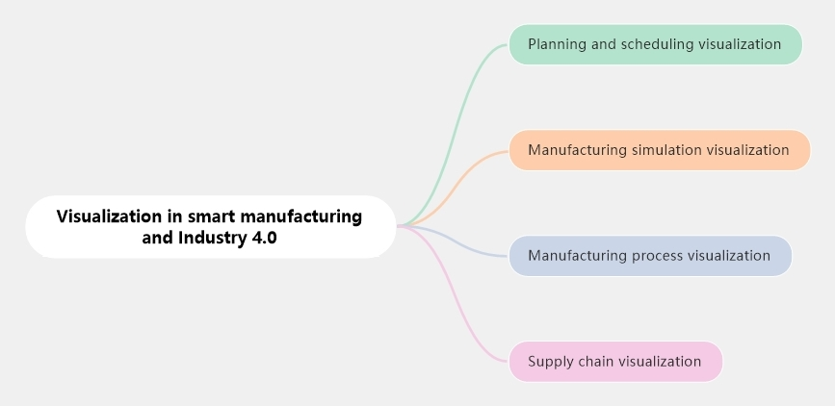
Research Taxonomy
Visualization in Smart Manufacturing
HKUST
Notes:
Since we collaborated with analysts from Automotive industry, we also focus on the car faults sequences.
Cars are complex system and contain many modules.
Car modules like…
Nowadays most can brands…
The emitted fault signals forms a sequence of car faults.

Slide 13
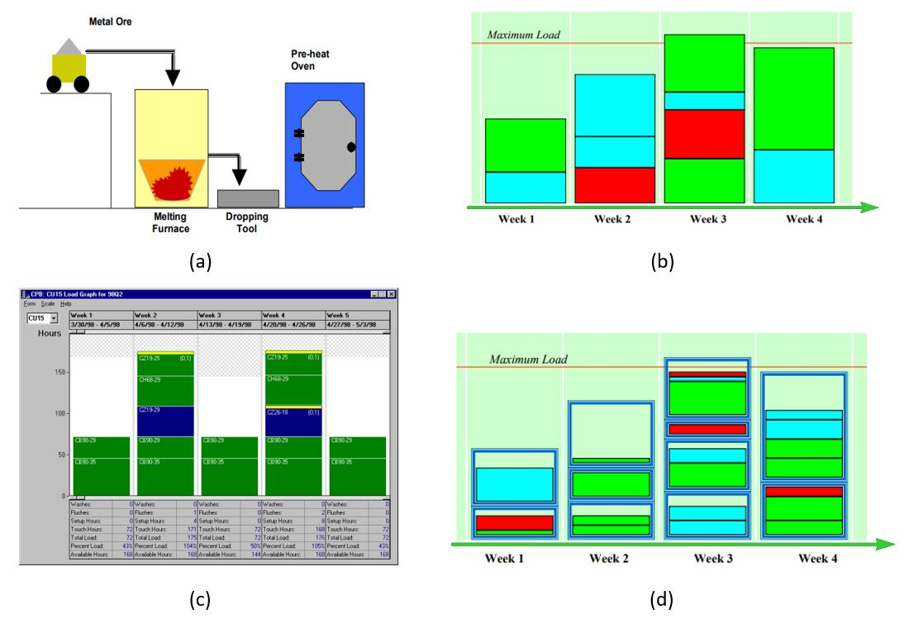
Planning and Scheduling Visualization
Visualization in Smart Manufacturing
How to explore and optimize product planning under certain constraints?
Constraints
Machine load
Equipment capacity
Bar chart-based visualization
Visually adjust the plan
(Wu, 2001) Information Visualization
HKUST
Notes:
Since we collaborated with analysts from Automotive industry, we also focus on the car faults sequences.
Cars are complex system and contain many modules.
Car modules like…
Nowadays most can brands…
The emitted fault signals forms a sequence of car faults.

Slide 14
Planning and Scheduling Visualization
Visualization in Smart Manufacturing
How to explore and optimize product planning under certain constraints?
Pros:
Intuitive and effective
User friendly
Reveals bottlenecks
Cons:
Other constraints?
Coarse-grained
(Wu, 2001) Information Visualization
HKUST
Notes:
Since we collaborated with analysts from Automotive industry, we also focus on the car faults sequences.
Cars are complex system and contain many modules.
Car modules like…
Nowadays most can brands…
The emitted fault signals forms a sequence of car faults.

Slide 15
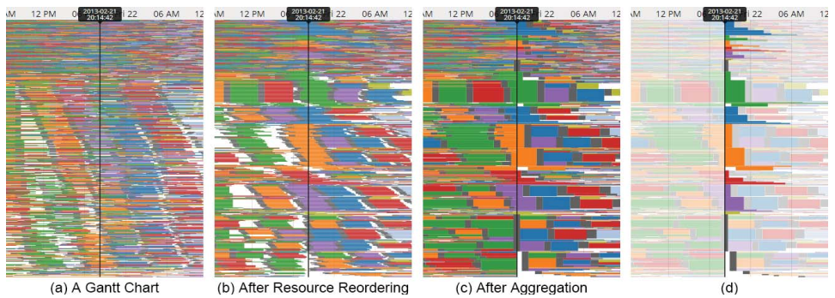
Planning and Scheduling Visualization
Visualization in Smart Manufacturing
How to alleviate visual clutter and reveal frequent sequences in scheduling?
LiveGantt (Jo et al., 2014) TVCG
Visualization: the extended Gantt chart.
Severe visual clutter in the Gantt chart.
Adopt reordering and aggregation algorithms to reveal highly concurrent scheduling.
HKUST
Notes:
Since we collaborated with analysts from Automotive industry, we also focus on the car faults sequences.
Cars are complex system and contain many modules.
Car modules like…
Nowadays most can brands…
The emitted fault signals forms a sequence of car faults.

Slide 16
Planning and Scheduling Visualization
Visualization in Smart Manufacturing
How to alleviate visual clutter and reveal frequent sequences in scheduling?
LiveGantt (Jo et al., 2014) TVCG
Pros:
Reduce visual cluster
Disclose highly concurrent sequences
Cons:
Only reveal sequences following the timeline
Difficult to compare different sequences
HKUST
Notes:
Since we collaborated with analysts from Automotive industry, we also focus on the car faults sequences.
Cars are complex system and contain many modules.
Car modules like…
Nowadays most can brands…
The emitted fault signals forms a sequence of car faults.

Slide 17
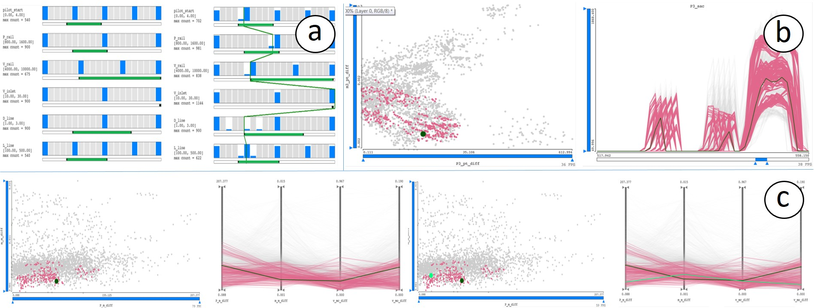
Manufacturing Simulation Visualization
Visualization in Smart Manufacturing
How to decrease required simulation ensembles for exploration?
(Matkovic et al., 2014) TVCG
Combine optimization algorithms with visual exploration.
Decrease required simulation runs and guide parameter selection
HKUST
Notes:
Since we collaborated with analysts from Automotive industry, we also focus on the car faults sequences.
Cars are complex system and contain many modules.
Car modules like…
Nowadays most can brands…
The emitted fault signals forms a sequence of car faults.

Slide 18

Manufacturing Simulation Visualization
Visualization in Smart Manufacturing
How to decrease required simulation ensembles for exploration?
(Matkovic et al., 2014) TVCG
Pros:
Reduce the number of data for exploration.
Combine the advantages of both optimization algorithms and human judgment.
Cons:
Does not explain why the result is optimal.
Difficult to compare different parameter configurations for different purposes.
HKUST
Notes:
Since we collaborated with analysts from Automotive industry, we also focus on the car faults sequences.
Cars are complex system and contain many modules.
Car modules like…
Nowadays most can brands…
The emitted fault signals forms a sequence of car faults.

Slide 19
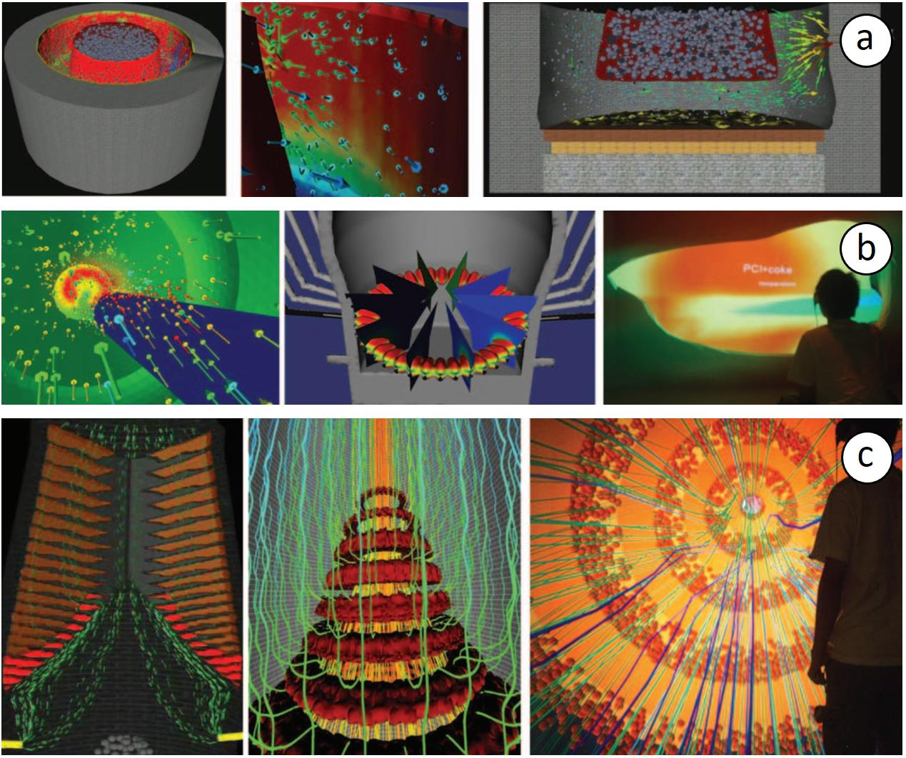
Manufacturing Simulation Visualization
Visualization in Smart Manufacturing
How does the complex production process work?
Visualize the steel manufacturing process.
Volume Rendering +
Augmented Reality (AR)
(Zhou, 2011) Iron & Steel Technology
HKUST
Notes:
Since we collaborated with analysts from Automotive industry, we also focus on the car faults sequences.
Cars are complex system and contain many modules.
Car modules like…
Nowadays most can brands…
The emitted fault signals forms a sequence of car faults.

Slide 20

Manufacturing Simulation Visualization
Visualization in Smart Manufacturing
How does the complex production process work?
(Zhou, 2011) Iron & Steel Technology
Pros:
Immersive environment.
Explain the complex process in a simple and intuitive way.
Cons:
Visual clutter and occlusion.
No visual summary.
HKUST
Notes:
Since we collaborated with analysts from Automotive industry, we also focus on the car faults sequences.
Cars are complex system and contain many modules.
Car modules like…
Nowadays most can brands…
The emitted fault signals forms a sequence of car faults.

Slide 21
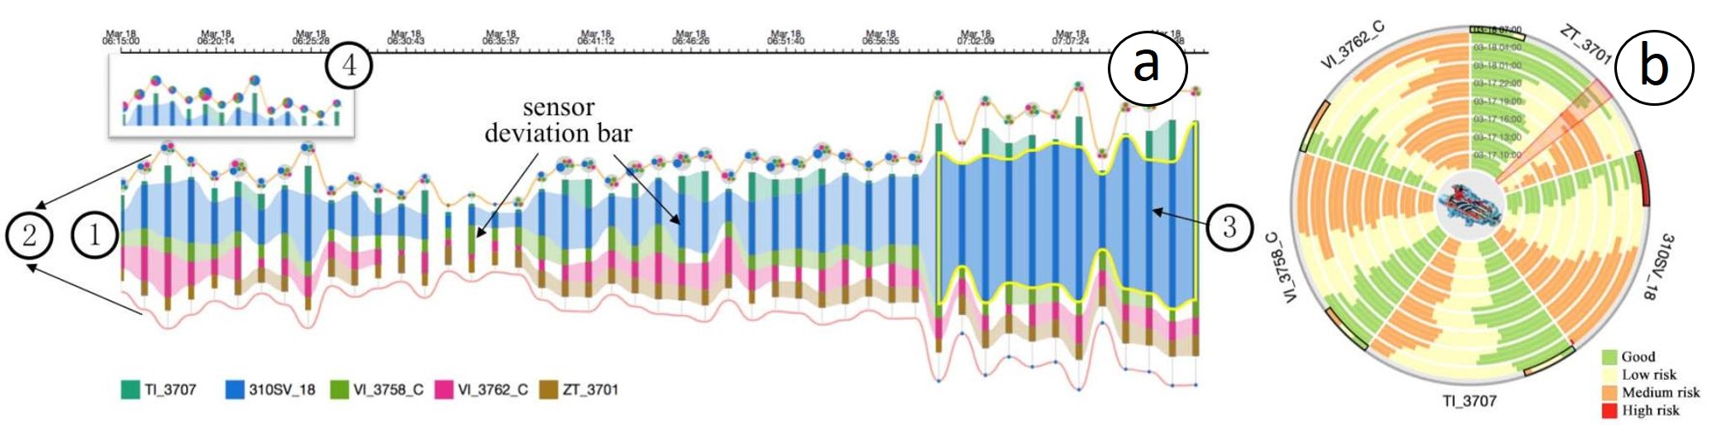
Manufacturing Process Visualization
Visualization in Smart Manufacturing
How to detect risks? when does the system need maintenance?
(Wu et al., 2018) PacificVis
Employ advanced algorithms to reveal the risk level of time series data.
Visualization: the stacked bar chart, the pack layout, and the ring map.
HKUST
Notes:
Since we collaborated with analysts from Automotive industry, we also focus on the car faults sequences.
Cars are complex system and contain many modules.
Car modules like…
Nowadays most can brands…
The emitted fault signals forms a sequence of car faults.

Slide 22
Manufacturing Process Visualization
Visualization in Smart Manufacturing
How to detect risks? when does the system need maintenance?
(Wu et al., 2018) PacificVis
Pros:
Easy to identify sensors in the high risk level.
Guide predictive maintenance.
Cons:
Do not consider the topology of sensors.
Do not verify the correctness of the algorithm.
HKUST
Notes:
Since we collaborated with analysts from Automotive industry, we also focus on the car faults sequences.
Cars are complex system and contain many modules.
Car modules like…
Nowadays most can brands…
The emitted fault signals forms a sequence of car faults.

Slide 23
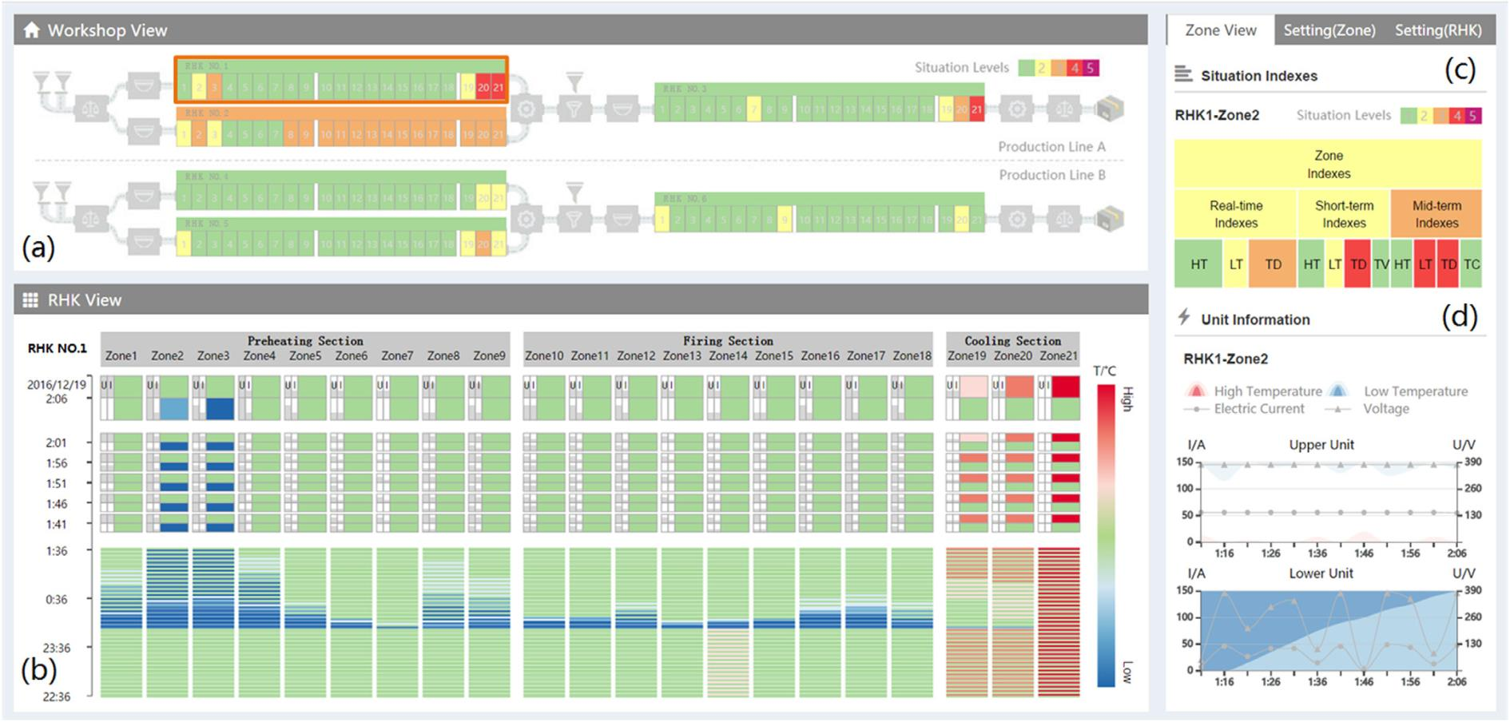
Manufacturing Process Visualization
Visualization in Smart Manufacturing
How to detect risks? when does the system need maintenance?
Heatmap, multi-scale exploration
(Zhou et al., 2018) Journal of Visual Languages & Computing
Adopt a situation awareness model to monitor facilities in a factory producing lithium battery cathode materials.
HKUST
Notes:
Since we collaborated with analysts from Automotive industry, we also focus on the car faults sequences.
Cars are complex system and contain many modules.
Car modules like…
Nowadays most can brands…
The emitted fault signals forms a sequence of car faults.

Slide 24
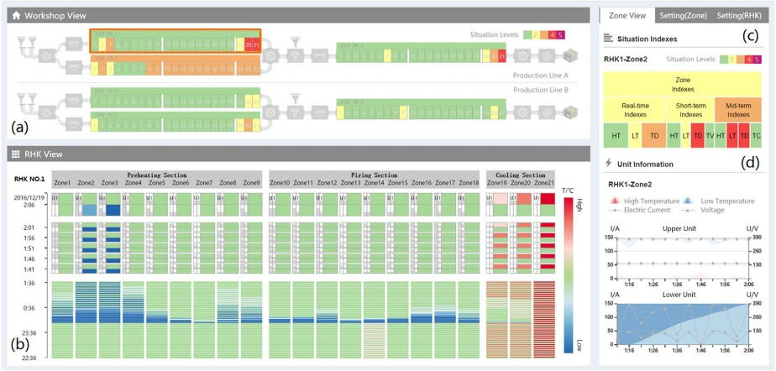
Manufacturing Process Visualization
Visualization in Smart Manufacturing
How to detect risks? when does the system need maintenance?
(Zhou et al., 2018) Journal of Visual Languages & Computing
Pros:
Intuitive, easy to use
Help non-experts understand and locate problems.
Cons:
Cannot display equipment condition in a long time span.
Scalability: not suitable for a larger system.
HKUST
Notes:
Since we collaborated with analysts from Automotive industry, we also focus on the car faults sequences.
Cars are complex system and contain many modules.
Car modules like…
Nowadays most can brands…
The emitted fault signals forms a sequence of car faults.

Slide 25
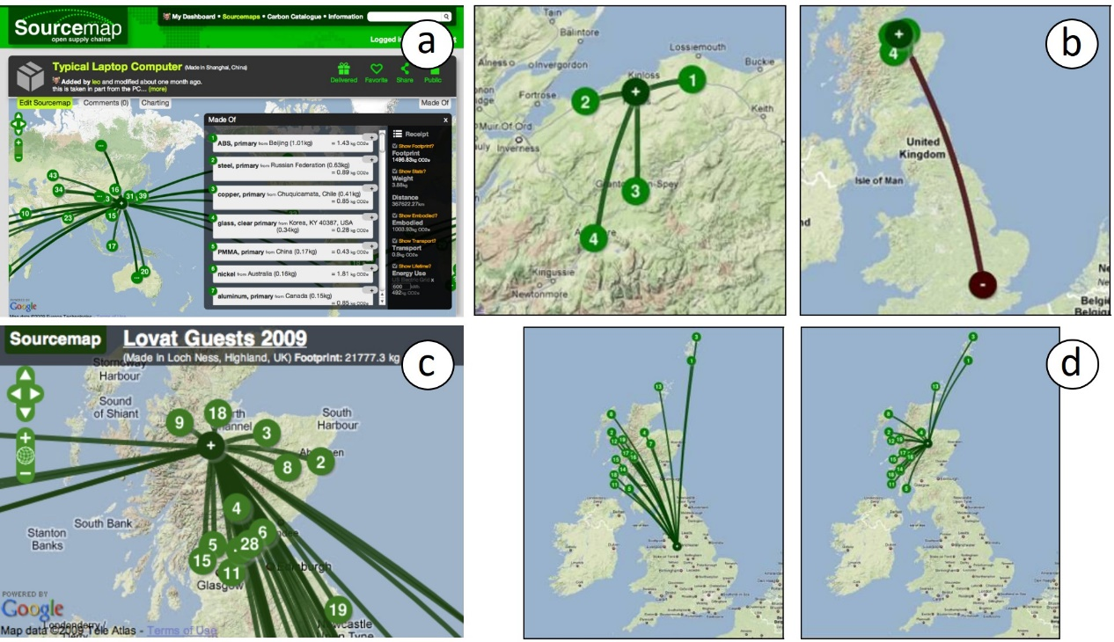
Supply Chain Visualization
Visualization in Smart Manufacturing
How to optimize the design of supply chains?
Sourcemap (Bonanni et al., 2010) CHI
Graph-based visualization, incorporate geographic information.
Reveal the transportation path and the carbon footprint.
HKUST
Notes:
Since we collaborated with analysts from Automotive industry, we also focus on the car faults sequences.
Cars are complex system and contain many modules.
Car modules like…
Nowadays most can brands…
The emitted fault signals forms a sequence of car faults.

Slide 26
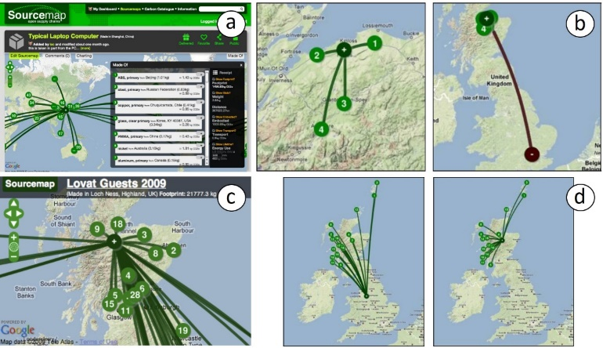
Supply Chain Visualization
Visualization in Smart Manufacturing
How to optimize the design of supply chains?
Sourcemap (Bonanni et al., 2010) CHI
Pros:
Supporting visually designing the supply chain network.
Intuitive and easy.
Cons:
Do not consider the uncertainty in demands.
Do not support what-if analysis.
HKUST
Notes:
Since we collaborated with analysts from Automotive industry, we also focus on the car faults sequences.
Cars are complex system and contain many modules.
Car modules like…
Nowadays most can brands…
The emitted fault signals forms a sequence of car faults.

Slide 27
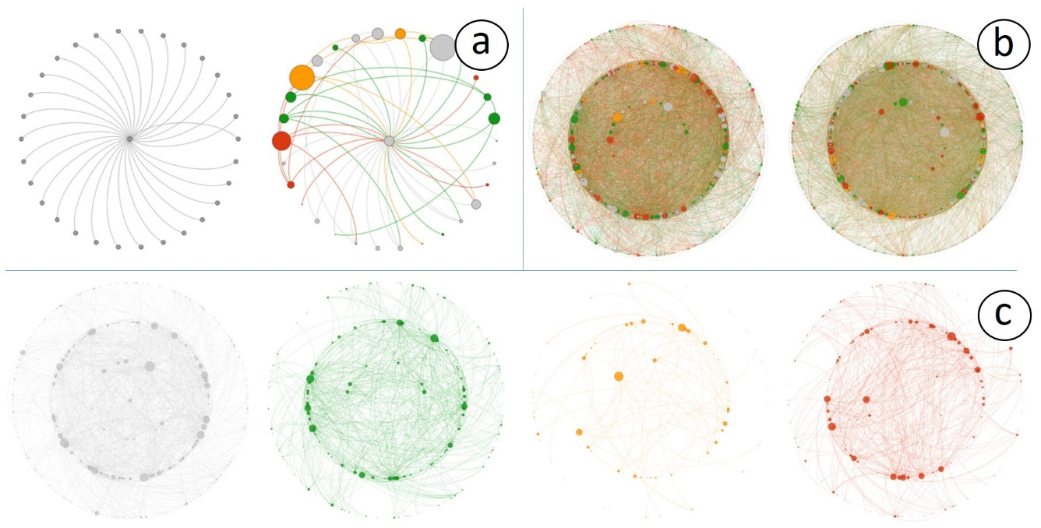
Supply Chain Visualization
Visualization in Smart Manufacturing
How to reveal the risk interrelationships between different companies?
(Basole et al., 2014) Decision Support Systems
Visualization: the node-link diagram, the ego-centric network
Interrelationships and risk levels of companies in a three-tier supply chain network.
HKUST
Notes:
Since we collaborated with analysts from Automotive industry, we also focus on the car faults sequences.
Cars are complex system and contain many modules.
Car modules like…
Nowadays most can brands…
The emitted fault signals forms a sequence of car faults.

Slide 28
Supply Chain Visualization
Visualization in Smart Manufacturing
How to reveal the risk interrelationships between different companies?
(Basole et al., 2014) Decision Support Systems
Pros:
Support subtier network analysis.
Reveal patterns of different risk levels.
Cons:
Only local views.
No geographical information.
HKUST
Notes:
Since we collaborated with analysts from Automotive industry, we also focus on the car faults sequences.
Cars are complex system and contain many modules.
Car modules like…
Nowadays most can brands…
The emitted fault signals forms a sequence of car faults.

Slide 29
Conclusion
Visualization in Smart Manufacturing
Visualization in planning and Scheduling
Interactively optimize the planning, the scheduling, and process layouts.
Visualization in manufacturing simulation
Configure parameters, diagnose problems, and understand manufacturing.
Visualization in manufacturing processes
Reveal inefficiencies, anomalies, and bottlenecks; predictive maintenance.
Visualization in supply chain
Visually design the supply chain network; reveal patterns in risks.
HKUST
Notes:
Since we collaborated with analysts from Automotive industry, we also focus on the car faults sequences.
Cars are complex system and contain many modules.
Car modules like…
Nowadays most can brands…
The emitted fault signals forms a sequence of car faults.

Slide 30
Future Work
Visualization in Smart Manufacturing
The uncertainty and multiple constraints of planning are still unresolved.
Reflect uncertainty in demands.
Combine various constraints together.
Predictive maintenance is not fully explored.
Self-monitoring.
Maintenance on demand.
What-if analysis is needed.
What if there is unpredictable fault?
What if there is a increase / decrease in demands / supplies?
The algorithm result is not explained and convincing.
Leverage domain knowledge to understand and build the model.
HKUST
Notes:
Since we collaborated with analysts from Automotive industry, we also focus on the car faults sequences.
Cars are complex system and contain many modules.
Car modules like…
Nowadays most can brands…
The emitted fault signals forms a sequence of car faults.

Slide 31
Our Approach
Sequence Synopsis: Optimize Visual Summary of Temporal Event Data
System
Evaluation & Summary
HKUST
Notes:
First, let me introduce you the background and motivation of visualization in Industry 4.0.

Slide 32
Sequence Synopsis: Optimize Visual Summary of Temporal Event Data
IEEE Transactions on Visualization and Computer Graphics (TVCG), 2018
Yuanzhe Chen¹, Panpan Xu², Liu Ren²
¹Hong Kong University of Science and Technology ²Bosch Research North America
Notes:
I am Yuanzhe
This is a joint work with
When I was an intern

Slide 33
Use Case: Car Faults Analysis
Event Sequences
Car modules like ECUs (electronic control units) / sensors emits fault signals like DTCs (diagnostics trouble codes) during operation.
Fault data is archived for most car brands.
Repair / maintenance
08-21 12:30 GPS inoperative
08-20 10:00
Car battery low
08-22 12:30
Short circuit
X
A
B
C
t
HKUST
Notes:
Since we collaborated with analysts from Automotive industry, we also focus on the car faults sequences.
Cars are complex system and contain many modules.
Car modules like…
Nowadays most can brands…
The emitted fault signals forms a sequence of car faults.

Slide 34

Use Case: Car Faults Analysis
Event Sequences
What are the typical development paths of faults? (Identify sequential patterns )
Do cars matched to the same pattern come from the same country? (correlation analysis)
……
D
A
B
C
A
E
B
C
E
A
B
C
Insights support predictive diagnostics (i.e. identify faults likely to happen in the future).
Better driving experience & warranty cost saving.
……
t
HKUST
Notes:
When analyzing such sequences, two questions are often asked by the analysts.
First…
Second…
By answering these questions, analysts can get insights to…

Slide 35
Use Case: Car Faults Analysis
Event Sequences
What are the typical development paths of faults? (Identify sequential patterns )
Do cars matched to the same pattern come from the same country? (correlation analysis)
……
D
A
B
C
A
E
B
C
E
A
B
C
Robust to noisy data
Interpretable results
Succinct visual overview
……
t
HKUST
Notes:
When analyzing such sequences, two questions are often asked by the analysts.
First…
Second…
By answering these questions, analysts can get insights to…

Slide 36
Our approach

Slide 37
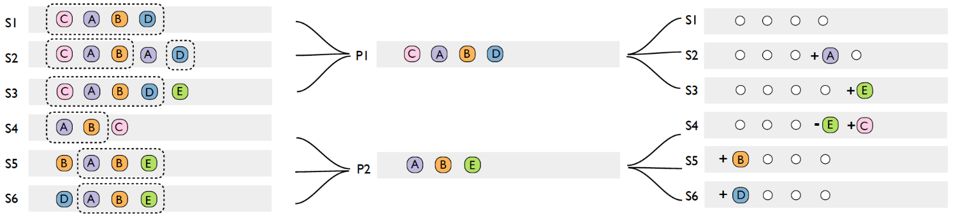
Overview
Our Approach – Sequence Synopsis
Two-part representation of event sequences as lossless compression of the data
Optimal pattern set selection for visual summary based on the Minimum Description Length (MDL) principle
Optimization algorithm
Speedup with locality sensitive hashing
HKUST
Notes:
In this paper, we propose a novel approach to visually summarize event sequences.
Our method is based on a two part representation of event sequences, where we represent sequences with a set patterns and corrections
Then, based on Minimum Description Length principle, we can select the optimized pattern set to summarize the data.
Then…
I will give more details about the first two points here which tells you what is the proposed visual summary and briefly introduce how we calculate it.

Slide 38
Two-Part Representation of Event Sequences
Our Approach – Sequence Synopsis
D
A
B
C
A
E
B
C
E
A
B
C
Representative pattern
summarizes multiple sequences.
A
B
C
HKUST
Notes:
So what is the two-part representation
Given three cars and their fault sequences, we can identify the common part, which is… we call it the …and intuitively, this pattern can be a summary of these three sequences.

Slide 39
Two-Part Representation of Event Sequences
Our Approach – Sequence Synopsis
D
A
B
C
Corrections - event insertions (edits) recover the original sequences from the pattern.
A
E
B
C
E
A
B
C
Representative pattern
summarizes multiple sequences.
A
B
C
Use sequential patterns for visual summary.
Model information loss with the required edits (corrections).
HKUST
Notes:
Then to recover the sequences with the pattern , the inserted events are defined as corrections, or edits.
So pattern and corrections is the two-part representation of event sequences.
We can use sequential patterns…

Slide 40
Two-Part Representation of Event Sequences
Our Approach – Sequence Synopsis
D
A
B
C
A
E
B
C
E
Event deletion is another possible type of edit.
A
B
C
Representative pattern
summarizes multiple sequences.
A
B
C
Different types of edits allow different variations from the pattern. Enable noise tolerant & robust pattern matching.
HKUST
Notes:
Besides inserting events, we can also allow recovering the sequences from pattern by delete certain events, like…
So different types of… We can also define other type of edits besides insertion and deletion. The ability to generalize the edits makes…

Slide 41

Two-Part Representation of Event Sequences
Our Approach – Sequence Synopsis
Event Sequences
=
Patterns
+
Edits (Corrections)
What can be considered as a good set of patterns to summarize a collection of event sequences?
HKUST
Notes:
This figure shows a more generic example. Here we summarize … into two patterns.
Whether this is a good summary or not? Why not summarize…
Here we need to define what is a god set of patterns for visual summary.
The basic observation is that we want both small number of patterns and edits. Because…

Slide 42
The Minimum Description Length (MDL) Principle
Our Approach – Sequence Synopsis
The best model (or hypothesis) of a data set should minimize its total description length:
L = L(M) + L(D|M)
Model description length
Data description length with the help of the model
Widely used information-theoretic criteria for model selection
Introduced by Jorma Rissanen in 1978
Formalizes “Occam’s Razor”
“We consider it a good principle to explain the phenomena by the simplest hypothesis [model] possible.” (but not simpler)
- Ptolemy (c. AD 90 – c. AD 168)
HKUST
Notes:
To find an optimized pattern set, we apply
MDL principle is widely used…originated from occam’s razor
It states that the best model is the simplest model, that is the model minimize total cost
And the cost consists of two part,…, which perfect fit with the observation I just mentioned.

Slide 43
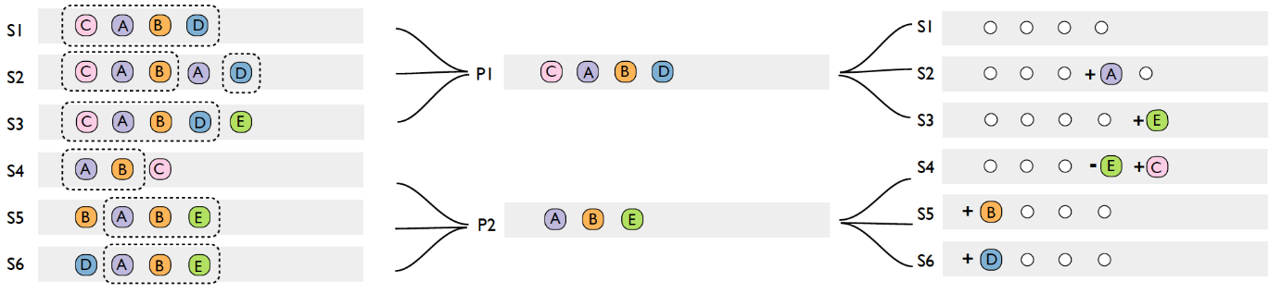

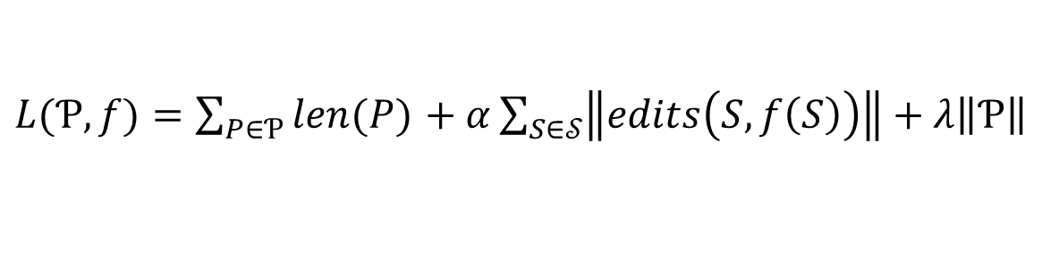
Description Length of Event Sequences
Our Approach – Sequence Synopsis
L = L(M) + L(D|M)
$L(Ƥ,f)=\sum_{P∈Ƥ}{len(P)}$ $+ α\sum_{S∈𝒮}{\left\|edits\left(S,f\left(S\right)\right)\right\|}+λ\left\|Ƥ\right\|$
# min edits (corrections)
sum(lengths of patterns)
6
7
Trade-off between reducing visual complexity & minimizing information loss.
HKUST
Notes:
Apply MDL to our problem, the model description length corresponds to …and the data description length corresponds to …
The last term… you can Refer to our paper for more detail.
According to MDL principle, we need find the pattern set which can minimize the total cost.
And the remark here is…since we want to visually summarize the data with patterns, the MDL finds the trade-off…

Slide 44
Optimize Description Length for the Best Set of Patterns
Our Approach – Sequence Synopsis
Basic Idea: iteratively find & merge two groups of sequences with maximum description length reduction
How to calculate description length reduction?
Find representative sequence for the merged group
Calculate the minimum number of edits (insertion, deletion, swapping event positions) needed to transform the representative sequence to the individual sequence in the merged group
Assuming insertion & deletion are allowed. Longest common subsequence (LCS) algorithm can be applied to calculate min #edits
Sum up the description length
HKUST

Slide 45
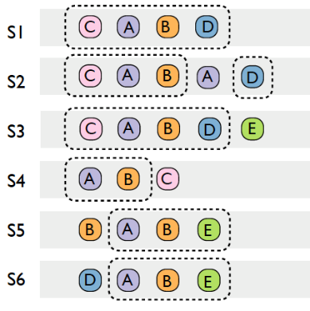
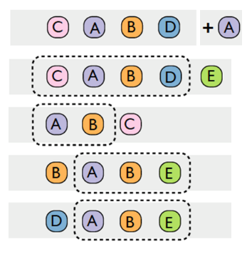
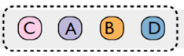
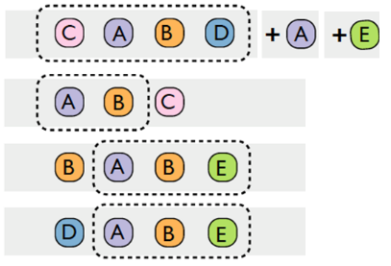
Optimize Description Length for Best Set of Patterns
Our Approach – Sequence Synopsis
Basic Idea: iteratively find & merge two groups of sequences with maximum description length reduction
-5
-4
…
HKUST
Notes:
The basic idea…
In this example, in the beginning,…we go through each pair of sequences and try to merge them as one pattern
Then we choose…and merged them as a new pattern
Keep doing this until no further reduction is possible

Slide 46
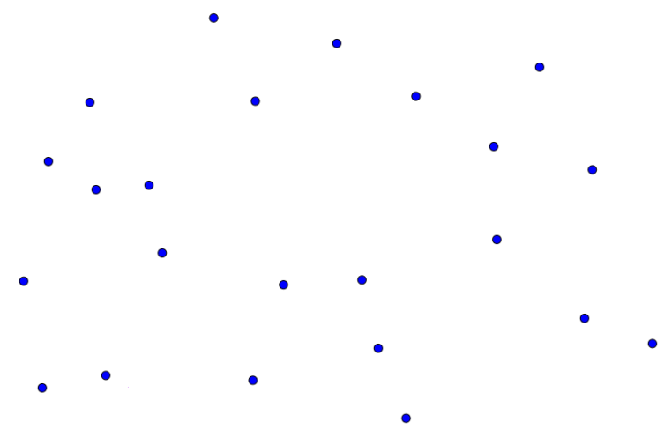
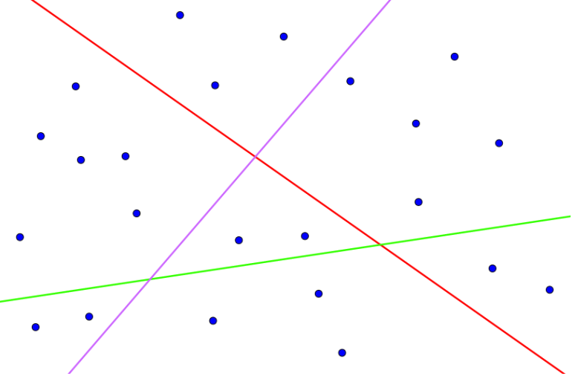
Algorithm Speedup through Locality Sensitive Hashing (LSH)
Our Approach – Sequence Synopsis
Bottleneck of the approach: find best pair of event sequence groups to merge
Locality sensitive hashing: algorithm for fast approximate neighbor search
HKUST
Notes:
To support interactive analysis, we further speed up…
In this example, each dot represents one sequence

Slide 47
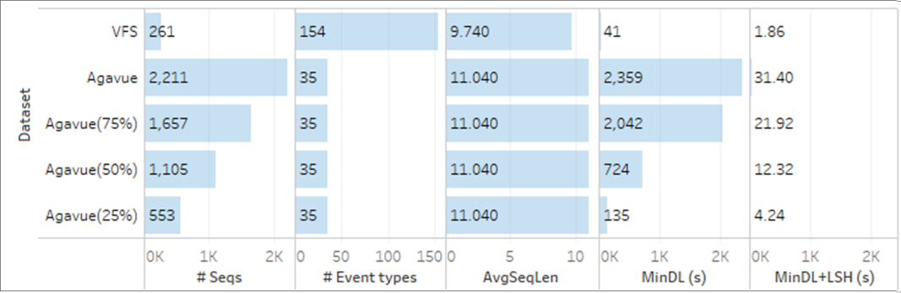
Algorithm Speedup through Locality Sensitive Hashing (LSH)
Our Approach – Sequence Synopsis
Bottleneck of the “vanilla” approach: find best pair of event sequence groups to merge
Locality sensitive hashing: algorithm for fast approximate neighbor search
20x ~ 50x speed gain with LSH compared with "vanilla" approach
HKUST
Notes:
To support interactive analysis, we further speed up…

Slide 48
Advantages
Our Approach – Sequence Synopsis
Simultaneous event sequence clustering and pattern extraction
Soft constraints on pattern matching, therefore robust to noisy data
Generalizability: possibility to include different sequence editing operations (e.g. event insertion, deletion, swapping positions)
HKUST
Notes:
To summarize, …

Slide 49
System

Slide 50
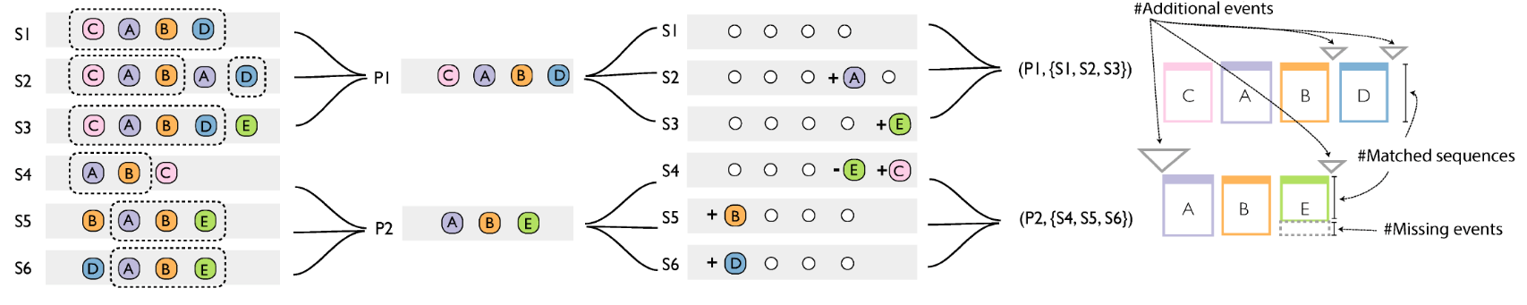
Visual Design
System
Original Data
Patterns
Corrections
Visual Design
HKUST
Notes:
Each pattern -> sequence
Height of the rectangle -> how many events match with the pattern -> missing events E
Triangle -> insertion
Larger triangle -> more insertion

Slide 51
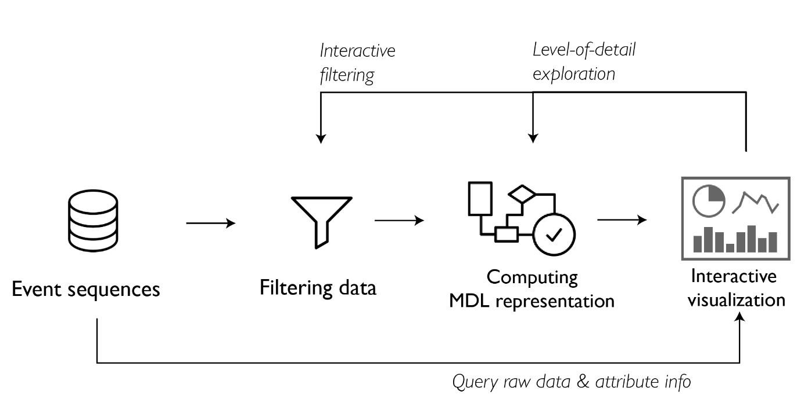
Architecture
System
HKUST
Notes:
We also built an visualization system to support interactive analysis. Here is the system architecture.

Slide 52
Supportive Views, UI, Case Study – Vehicle Fault Analysis
System
HKUST

Slide 53
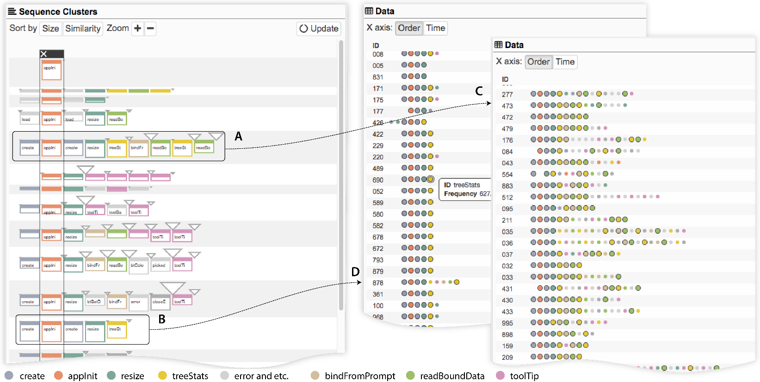
Case Study – Application Log Analysis
System
Dataset:
D. Fisher. Agavue event data sample
Size:
~2000 user sessions
Description:
Interaction log of using a data visualization application
HKUST
Notes:
We also applied our method to application log analysis.
Here we use a public dataset contains 2000 user sessions.
Each session records the actions when a user interact with the application to generate visualization like bar chart or treemap.
A… B…less variation

Slide 54
Evaluation & Summary

Slide 55
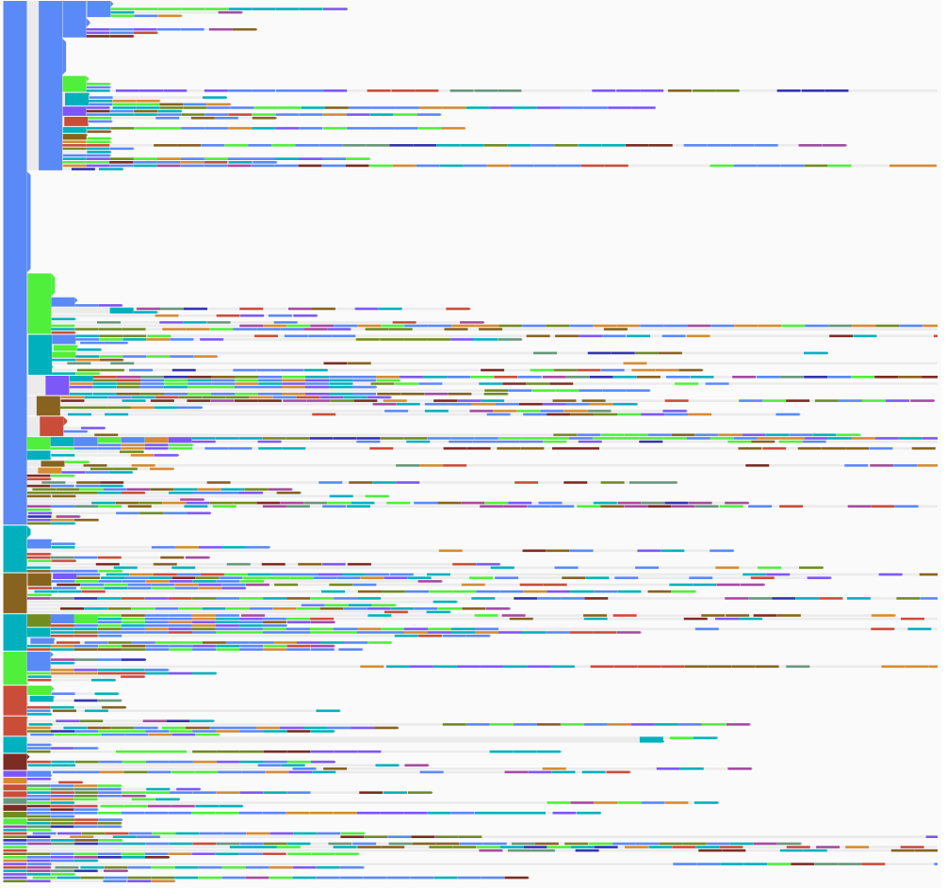
Comparative Experiment
Evaluation & Summary
Dataset: Vehicle Faults
Left: EventFlow
Right: Sequence Synopsis
HKUST
Notes:
Emphasize that our approach is noise tolerant

Slide 56
Contributions
Evaluation & Summary
A new application domain of event sequence visualization
A generic two-part representation of event sequences that:
Quantifies visual complexity & information loss in visual summaries
Combined with the MDL principle, defines an optimal set of patterns for summary
An efficient algorithm to optimize visual summary using LSH
A visual analytics system that supports interactive analysis of real-world event sequences from different application domains
HKUST

Slide 57
Future Work
Evaluation & Summary
Revise model representation to discover multiple patterns in a single sequence
Towards quantifiable visual designs by applying the MDL principle to different types of data: graph/networks, time series …
HKUST

Slide 58
Introduction
ViDX: Visual Diagnostics of Assembly Line Performance in Smart Factories
The ViDX System
Summary
HKUST
Notes:
First, let me introduce you the background and motivation of visualization in Industry 4.0.

Slide 59


Panpan Xu et al.
ViDX: Visual Diagnostics of Assembly Line Performance in Smart Factories
Best Paper Honorable Mention
IEEE VAST, Oct 2016

Slide 60
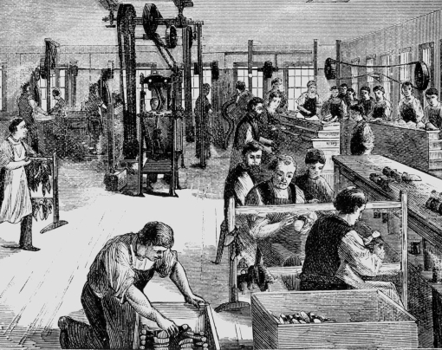

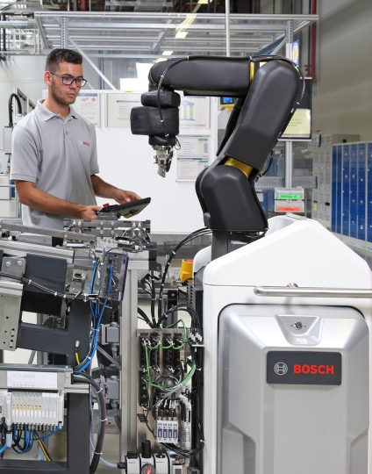

Smart factories in Industry 4.0
Introduction
Manufacturing today.
Towards Industry 4.0 (a.k.a. connected industry, industrial internet)
Factories in the 19th century*.
Digitalized
Automated
Connected
*Image source: http://www.alamy.com/stock-photo/19th-century-factory.html
60
Research and Technology Center North America | CR/RTC1.4-NA | 8/21/2016
© 2016 Robert Bosch LLC and affiliates. All rights reserved.
Notes:
Manufacturing today is very different from the past.
Today we are in the middle of a evolution where the factories are becoming digitalized, automated, connected and increasingly smart
People call it the industry 4.0 , or … in different countries

Slide 61
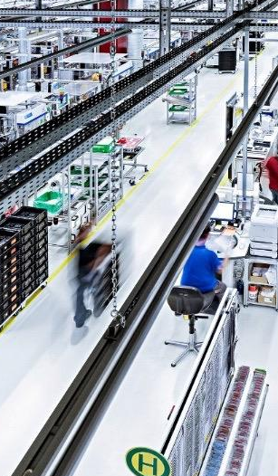
Big data in smart factories
Introduction
temperature,
humidity, pressure, …
Sensors
Data stream
cycle time,
progress, error, …
Status
Monitoring
Performance
Troubleshooting
Programmable
Logic
Controllers
location tracking info, …
Visual
Analytics
RFID*
Predictive Maintenance
Process Optimization
Data-driven decision making
* RFID: Radio frequency identification
61
Research and Technology Center North America | CR/RTC1.4-NA | 8/21/2016
© 2016 Robert Bosch LLC and affiliates. All rights reserved.
Notes:
But exactly how can factories be smart?
In the past years, people have installed a lot of sensors & digital controlling device to the ..
They collect a lot of data,
Transform the data into insights to support status monitoring,
How to do it?
visual analytics can play a very important role here

Slide 62

Challenges of real manufacturing data
Introduction
High volume & speed
Short cycle time (time to finish one step)
High throughput
High complexity
Tens to hundreds of measurements along a single manufacturing line
62
Research and Technology Center North America | CR/RTC1.4-NA | 8/21/2016
© 2016 Robert Bosch LLC and affiliates. All rights reserved.
Notes:
Challenges of real manufacturing data
Visualization can give a transparent overview of the complex and large manufacturing data

Slide 63
Our work
Introduction
Raise the awareness of this new, important and exciting research area for visual analytics
ViDX: The first visual analytics system for real manufacturing data in industry 4.0 applications.
Data provided by Bosch Anderson plant at South Carolina producing hydraulic modules, electronic modules and sensor elements in cars (deployment in progress)
Addressing challenges with novel visualization & interaction
Target user: shop floor technicians/operators and managers
Application: intuitive status monitoring & easy performance troubleshooting on assembly lines
Data: complex, large scale manufacturing process data.
63
Research and Technology Center North America | CR/RTC1.4-NA | 8/21/2016
© 2016 Robert Bosch LLC and affiliates. All rights reserved.
Notes:
We take on real data set from a manufacturing plant capturing their operation histories .
And introduce …

Slide 64
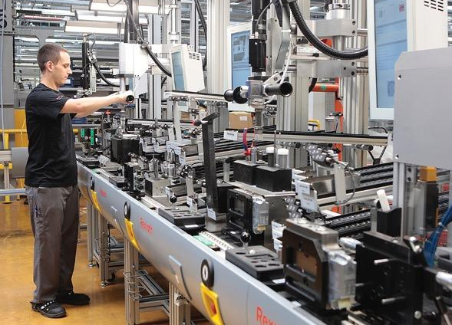
Data
The ViDX System
Parts/Products A, B, C …
Data:
When a part/product arrives at which station (with the derived cycle time)
Which fault occurred
12:00:03 Oct 28
Cycle Time
12:00:58 …
Fault occured
Work Station S1
12:01:08 …
Work Station S2
Work Station S3
64
Research and Technology Center North America | CR/RTC1.4-NA | 8/21/2016
© 2016 Robert Bosch LLC and affiliates. All rights reserved.
Notes:
The first step
what kind of data?
Data come from assembly line
A typical assembly line is composed of a sequence of work stations
the part goes through different stations to be processed and assembled to form the final product
Modern manufacturing lines controlled by programmable logic controller can trace when each product arrive at which station, and also record the error occurred in the process.

Slide 65
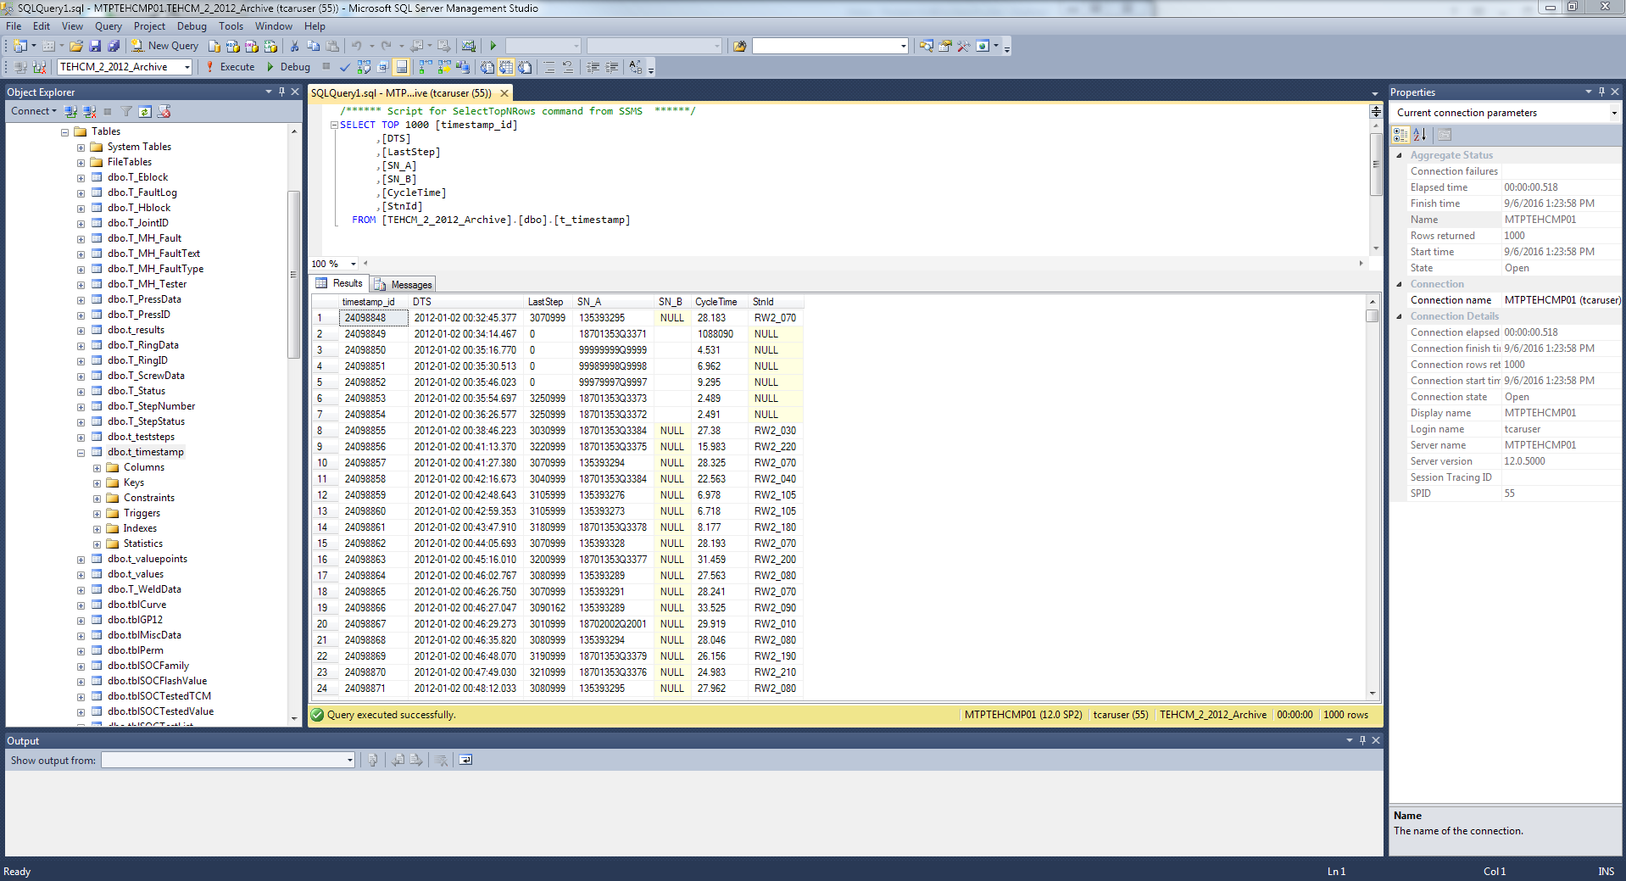
Data
The ViDX System
Database for historical records
(millions per year for a single production line).
65
Research and Technology Center North America | CR/RTC1.4-NA | 8/21/2016
© 2016 Robert Bosch LLC and affiliates. All rights reserved.
Notes:
A record For each and every one of the products about its history

Slide 66
Tasks & system requirements
The ViDX System
Task: performance troubleshooting
Identify when (during which minute/hour/day…), where (on which work station), how production efficiency decreases.
Determine the effect of faults on production efficiency.
Parts A, B, C …
12:00:03 Oct 28
12:00:58 …
Work Station S1
12:01:08 …
System requirements
Scalable to handle year long records.
Support both historical data analysis & real-time monitoring.
Work Station S2
Work Station S3
66
Research and Technology Center North America | CR/RTC1.4-NA | 8/21/2016
© 2016 Robert Bosch LLC and affiliates. All rights reserved.
Notes:
The data is just sitting in the database and but it actually has the potential to support the
Why real time monitoring?

Slide 67
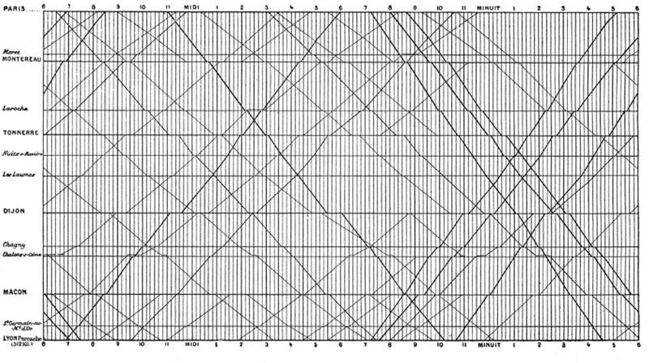
Inspiration: E.J. Marey’s graphical train schedule from 1880’s
The ViDX System
Train
Stations
67
Timeline
Research and Technology Center North America | CR/RTC1.4-NA | 8/21/2016
© 2016 Robert Bosch LLC and affiliates. All rights reserved.
Notes:
Our visual design is inspired by …, you can also find this graph in tufte’s book
thus, the slope of the line reflects the speed of the train: the steeper the line, the faster the train.
http://marlenacompton.com/?p=103

Slide 68
Idea 1: Visualize manufacturing processes as Marey’s Graph
The ViDX System
enter
00:02
S1
00:00
00:10
00:20
00:30
00:40
00:50
00:06
S2
00:08
Outlier process:
delayed at station S3’.
S3
S3’
Work
Stations
00:13
S7
S4
00:16
S8
S5
S6
00:30
S9
00:35
S10
00:37
00:00
00:10
00:20
00:30
00:40
00:50
leave
68
Research and Technology Center North America | CR/RTC1.4-NA | 8/21/2016
© 2016 Robert Bosch LLC and affiliates. All rights reserved.
Notes:
This is the manufacturing data visualized as marey’s graph
Instead of train stations, we now have …
Instead of trains, we have products

Slide 69
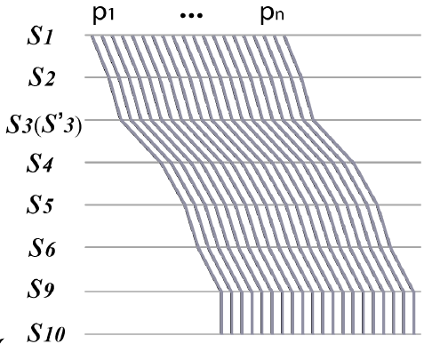
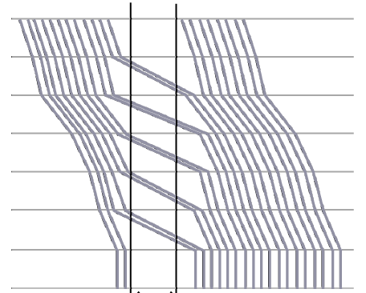
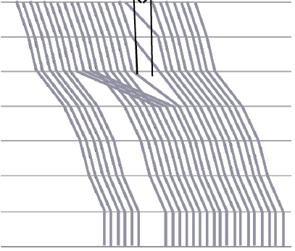
Intuitive visual patterns for performance troubleshooting
The ViDX System
☑Normal, efficient operation
☒The assembly line stopped
☒Processes stuck at some station
69
Research and Technology Center North America | CR/RTC1.4-NA | 8/21/2016
© 2016 Robert Bosch LLC and affiliates. All rights reserved.
Notes:
When we plot the real data, more visual patterns emerge,
Rhythmic pace
station s1 and s2 stopped processing, waiting for s3 to
finish handling the parts whose processing have been delayed

Slide 70
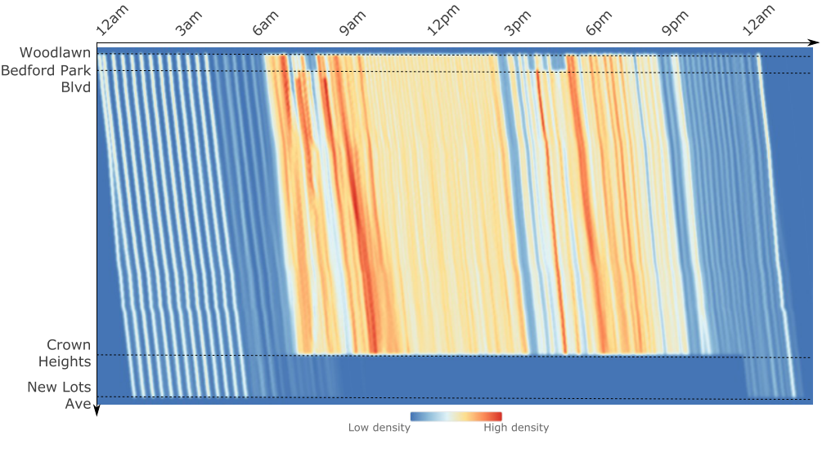
How to scale-up? (related work)
The ViDX System
Kernel density estimation (KDE)
Outliers blurred out.
Visualize public transportation schedules [Palomo et al. 2015]
70
Research and Technology Center North America | CR/RTC1.4-NA | 8/21/2016
© 2016 Robert Bosch LLC and affiliates. All rights reserved.
Notes:
Outliers hidden in visual clutters
One way to do
But the problem here is that kernel density estimation tends to blurr out the outliers

Slide 71
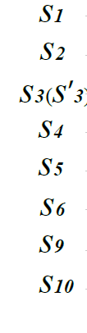
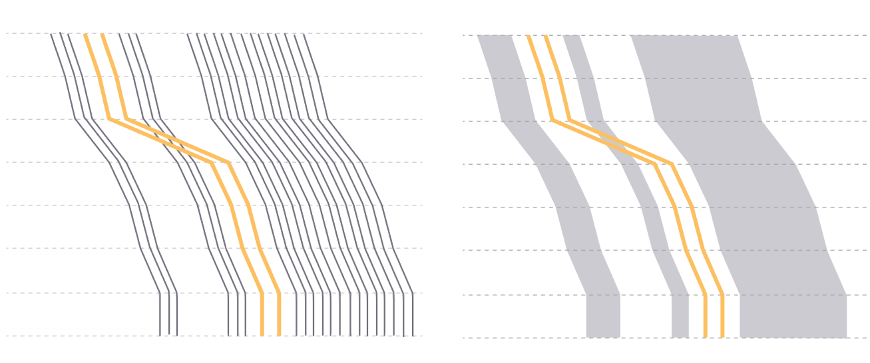
Idea 2: Interactive outlier detection and visualization.
The ViDX System
How to define the outliers?
Two interactive outlier detection techniques:
Samples brush
Quantiles brush
Keep outliers.
Aggregate normal processes.
Outlier-preserving visual aggregation.
71
Research and Technology Center North America | CR/RTC1.4-NA | 8/21/2016
© 2016 Robert Bosch LLC and affiliates. All rights reserved.
Notes:
We propose a different approach

Slide 72
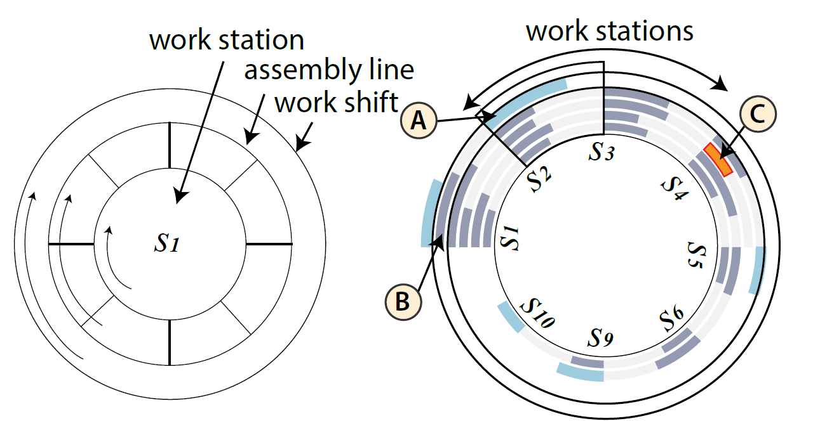
Animated radial graph for real-time production progress monitoring
The ViDX System
Original design proposed by the target user.
Redesigned graph.
72
Research and Technology Center North America | CR/RTC1.4-NA | 8/21/2016
© 2016 Robert Bosch LLC and affiliates. All rights reserved.
Notes:
three layers of concentric rotating circles. The inner
circle completes one cycle when a product finishes its procedures on one
station. The circle in the middle completes one cycle when the product
finishes its procedures on the entire assembly line. The outer circle completes
one cycle for an eight hour work shift. A slower rotation speed of
the inner circle means longer cycle time on a station.

Slide 73
User interview
The ViDX System
Participants
11 users, all have experience with basic visualization techniques (e.g., barcharts)
Summary of feedback
Samples brush is preferred over quantiles brush for its intuitiveness.
Extensions suggested to apply the current system for analyzing other process related parameters.
Deployment of the system in progress
“it’s very effective in the system’s ability to show real-time data [in the radial graph] and highlight abnormalities”
“This is a good interface for gaining an intuitive picture of how the line is running. These same methods could applied to process parameters during the manufacture of parts giving engineers the intuitive picture of process stability”.
73
Research and Technology Center North America | CR/RTC1.4-NA | 8/21/2016
© 2016 Robert Bosch LLC and affiliates. All rights reserved.

Slide 74
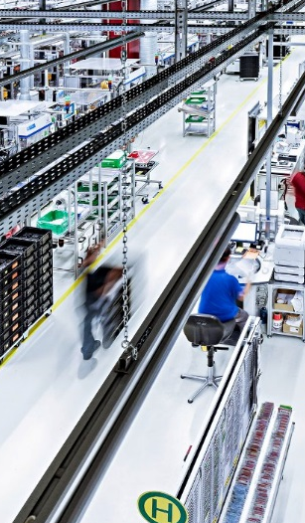
Contributions
Summary
The first visual analytics system for real data in Industry 4.0 applications.
Application & extension of the Marey’s graph to visualize large amount of manufacturing processes with outlier-preserving visual aggregation techniques.
Two novel interactive outlier detection techniques:
Samples brush based on label propagation algorithms
Quantiles brush based on statistical summaries
74
Research and Technology Center North America | CR/RTC1.4-NA | 8/21/2016
© 2016 Robert Bosch LLC and affiliates. All rights reserved.
Notes:
To summarize

Slide 75
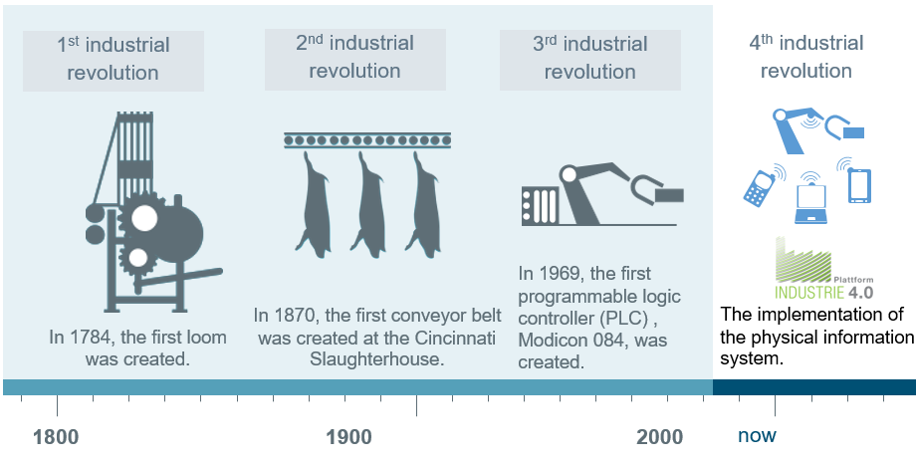
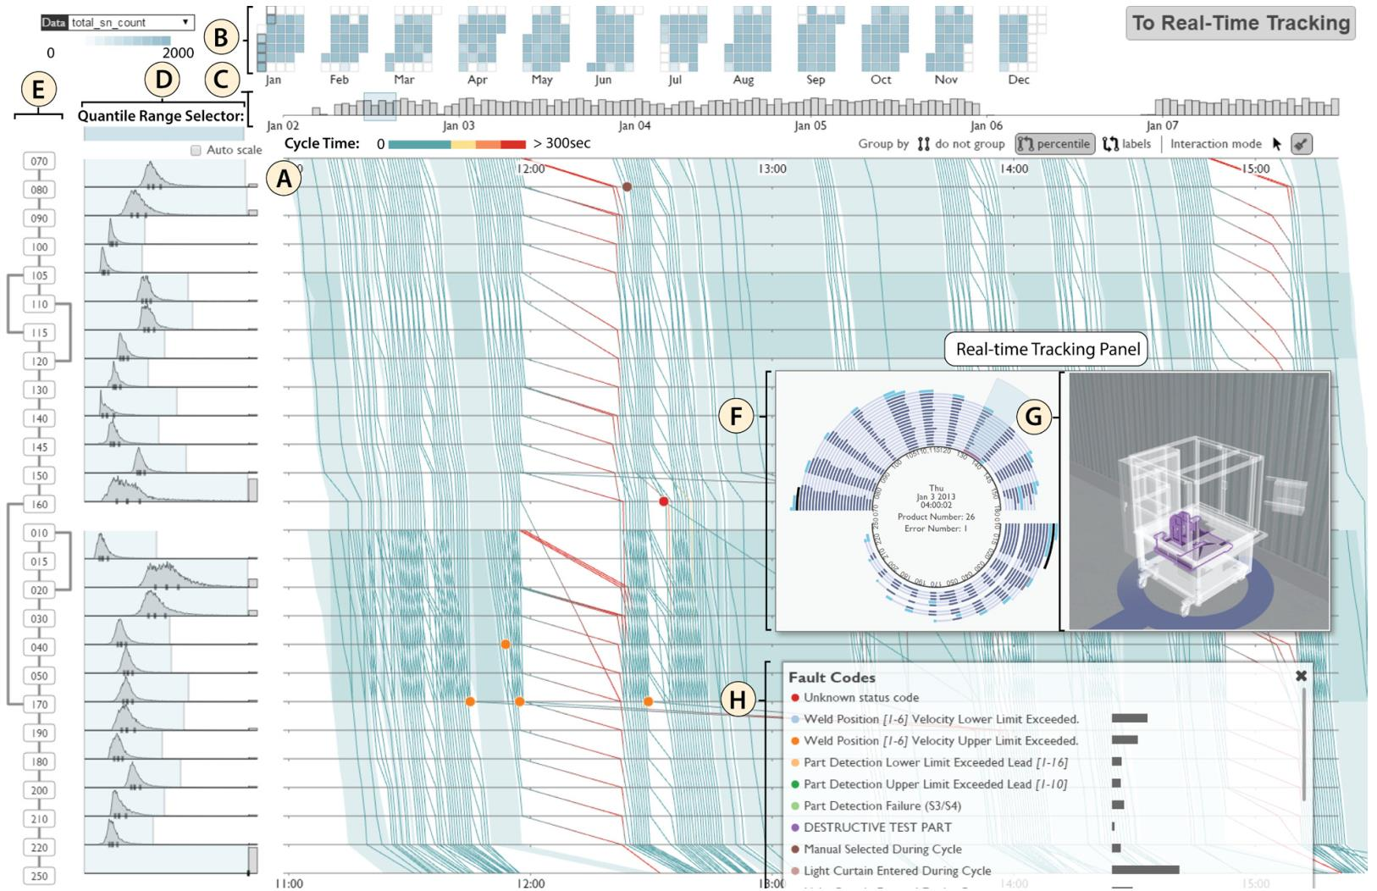
Thank You!
Dong SUN
dong.sun@connect.ust.hk
https://www.cse.ust.hk/~dsunae/

